Slide 1
Sting ad 30 years of history
Brief Introduction
OBJECTIVE
MISSION

Slide 2
OUR MISSION what is our mission? We strive to achieve and build with customers ...
Social Responsible Marketing
Marketing of relations
Pharmaceutical marketing in action
HOLISTIC MARKETING FRAME - communication, information, environment …..

Slide 3
and more….. we strive to :
respond to the requirements and exceed the expectations of our customers in terms of quality and timely service.
guarantee the safety of the goods we offer, their identity, purity and quality.
provide flexibility in terms of economic conditions without degrading the quality of the service provided.
deepen the knowledge of our customers in the development of state of the art pharmacy by organizing seminars and scientific meetings.
improve the organization of work at STING AD by implementation of Integrated Management System. It includes the requirements of ISO 9001; ISO 13485 and ISO 27001, and the Guide to Good Distribution Practice from Directive 2001/83/EC.
establish a basis for a "risk-based thinking" and implement mechanisms for identifying hazards / opportunities in order to mitigate risks and exploit them.
strive for a leading position in the wholesale medicinal products, medical devices and consumables, sanitary-hygienic materials, food supplements and cosmetic products, observing the norms of national legislation and the recommendations of the European Union.

Slide 4
profile
STING AD is a pharmaceutical logistic and marketing partner of manufacturers, pharmacies and hospitals.
The company is a full-line wholesaler of pharmaceutical products, medical devices, food supplements, cosmetic products and sanitary materials.
STING AD is a family company with a 30-year history.
It is a market leader in the pharmaceutical sector that serves on a daily basis more than 2,700 pharmacies over the entire territory of the country. The company owns 5 warehouses with over 248 vehicles and 750 highly qualified employees. The organization has more than 370 suppliers. Deliveries from manufacturers to Sting based on the absolute number of packages in 2022 marked a significant increase compared to the previous year (+0.34%), reaching over 119 million packages.
The company is an active participant in the pharmacy sector not only as a logistic center covering all the necessary requirements regarding storage and distribution but also as a marketing consultant for the customers (the pharmacies).

Slide 5
profile
The integrated management system of STING AD has been confirmed by Lloyd's Register Quality Assurance Limited. The company operates below the standard for 20 years and constantly develops the service quality on the basis of continuous feedback with the customers and the suppliers.
STING AD has an active marketing policy aiming to improve the pharmaceutical consultation and care for the patients. The company has a long-term strategy for the training of pharmacists and its own employees. The LEGE ARTIS post-graduate educational program has been implemented since 20 years.
The advertising and media communication of the company is with professional pharmaceutical scope. The monthly edition 'STING pharmaceutical products' magazine has a 20-year history. It is being distributed free of charge to the pharmacies and provides the up-to-date information in the sector.
STING AD is a distributor with a market share of 28% from the total market and 30% from the pharmacy segment. This is the only company in the sector that has been awarded eight times by the customers - the pharmacists - with the annual award 'Best distributor of the year'.
Date Value is May 2023 CHANNEL is RETAIL Period is MTH
Wholesaler | May Units | May Value | May Units% | May Value%
Sting | 6 064 556 | 92 032 474 | 30.92% | 28.97%
Phoenix | 5 543 889 | 80 298 450 | 28.27% | 25.28%
Pharmnet | 3 428 386 | 63 239 055 | 17.48% | 19.91%
Sopharma | 3 440 655 | 58 595 654 | 17.54% | 18.45%
Other | 426 395 | 12 724 761 | 2.17% | 4.01%

Slide 6
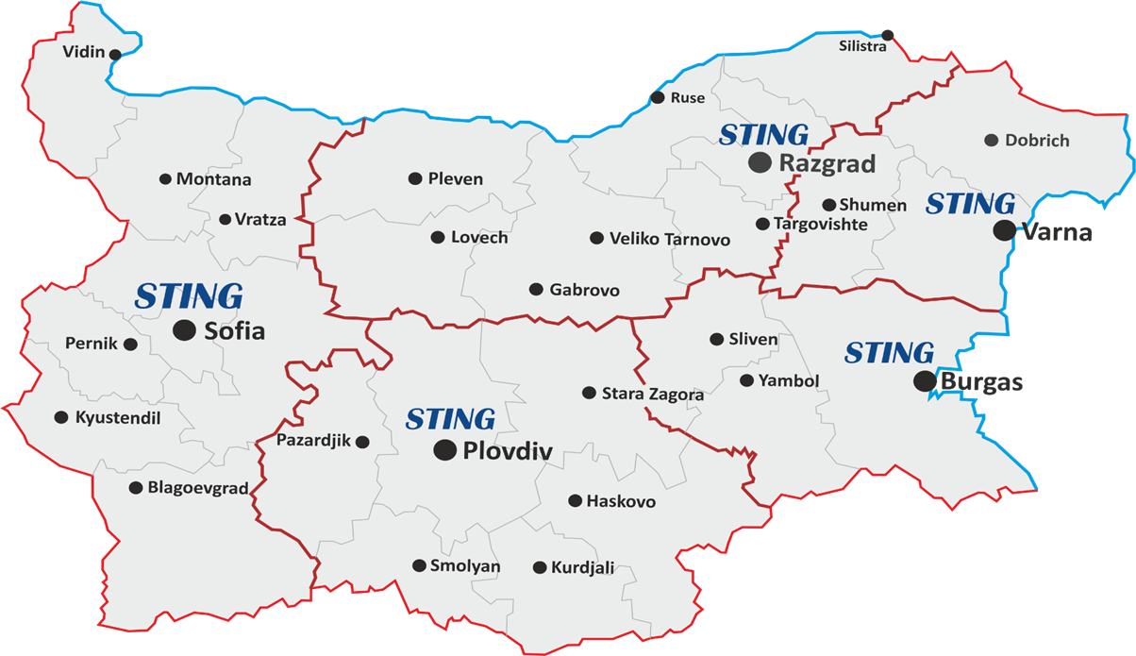
National Coverage - regional division of the territory serviced by STING AD warehouses

Slide 7
OBJECTIVE
To promote new suppliers providing exclusive rights to STING AD to market and distribute its products on the Bulgarian market using medical representatives and sales representatives for the projects assigned.
To continue organizing and conducting marketing activities to support customers.
To increase the efficiency of the chain work: "Manufacturer-Sting-pharmacies" through initiatives such as VU (as a virtual union of pharmacies, national union of pharmacies "Alliance Service AD").....
To maintain a leading position among distributors of pharmaceutical products in Bulgaria.
To achieve and maintain sustainable growth within 12%.

Slide 8
ECONOMIC FACTORS macro environment
The macroeconomic forecast of the Ministry of Finance predicts GDP growth of 1.8% in 2023 and reaching BGN 184.5 billion. In 2024, GDP growth will accelerate to 3.3%, and in 2025 expected to be 3.2%.
Expectations are that at the end of 2023, inflation will decrease to 5.6%, and the average annual rate will be 8.7%, which will be due to a significant reduction in the contributions of the groups of food and energy goods, which are expected to have a slight decline at the end of the year. In 2024, the forecast is that inflation will continue to slow down, reaching 3.2% at the end of the year, and the annual average - 3.8%. In 2025, the average annual inflation will continue to slow down to 2.8% respectively. Energy commodity prices will decline until the end of the forecast horizon.
Social-cultural factors have a significant impact on our activities. The main cultural values (literacy, low health culture, influences of media ads) have a constant impact, while the secondary values ones are more easily changed (for example high percentage of documents for temporary incapacity for work in line with the changing legalization ).
The demographic structure of the population is a primary factor in consumer preferences and product prices ... because in our country we have high morbidity and prevalence of chronic diseases, pensioners and the unemployed. The patients expect 100% coverage of medical services by the reimbursement system and free or low prices of medicinal products....
The political and legislative environment is unstable and the factors, related to this environment, are reflected in laws and other connected legal documents for regulation of business, which has an international and internal aspects and aims different goals….. for example, to protect production, vertical business structures, corporate interests.
The innovation techno-informational environment and the acceleration of the scientific and technical achievements are the opportunity to use new technologies for improvement of the warehouses for storing goods.
Social media forms opinion in consumer !
The negative demographic trend is also related to the hiring employees for the company's activities. .... high percentage of depopulated regions!

Slide 9
Micro environment
Customers:
PHARMACIES - the most developing segment of the pharmaceutical market ! Two subjects determine the dynamic of the market - individual pharmacies and large chains of pharmacies …..
We observe “Sifting” of individual pharmacies which are undergone on restructure because of professional consultation and support from our side
DROGERIES .......
HOSPITALS (private, state) ?!

Slide 10
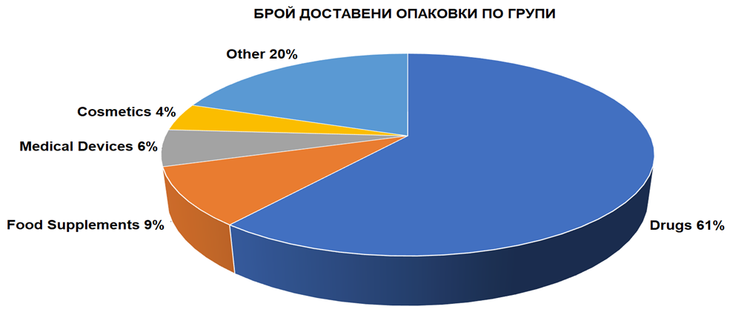
Micro environment
370 numbers of suppliers!
Suppliers
The total number of suppliers in 2021 remains almost the same compared to the previous years - about 370 companies. The tendency is to maintain a relatively constant number of suppliers. This is largely due to the merger of pharmaceutical companies and the unification of their product lists that began in recent years. Deliveries to the Sting company on a value basis have shown steady growth in recent years, increasing by 19% from BGN 702 million in 2020 to BGN 835 million in 2021. The increase is related to the increase in sales in recent years. This is mainly due to the high-cost positions.

Slide 11
Pharma Marketing
STING MARKETING COMMUNICATION MIX:
VIRTUAL UNION "in focus"- full national coverage of pharmacies - training of counter situated pharmacist for promotional and consulting skills in seasons
AUTUMN - Scientific marketing conference combined with an exhibition. It is performed with 500 top customers from the most reliable and successful pharmacies - type A and B, which are part of a national association of pharmacies "Alliance Service" AD.
Spring Marketing Conference - the main focus of the event is pharma marketing and digital pharmaceutical care.
Podcasts on YouTube - leading speakers discuss social topics
Product outsourcing (we can professionally present and promote different kind of products in front of pharmacists and doctors)…..
Co-operation with the
TRAINING
EXHIBITIONS
PROMOTIONS
M, E-PROJECTS

Slide 12
Activities
Pharmacy Design and Equipment- provide specialized pharmacy a furniture, in order to comply to the GPP standards
“PharmaStar” pharmacy software, aimed to assist pharmacy management optimization.
WEBSITE for on-line orders and payments, marketing and promotions of products

Slide 13
FUTURE GROWTH … ANALYSIS AND THE NEED FOR BALANCE
As healthcare marketers we all take into account that the healthcare is continuously developing process and that the need of “focus on patients” is critical for the commercial success. However, the reality is that daily business pressures and deeply ingrained processes often subjugate patient centricity to a “plaque on the wall” in the legislative conference room. Many companies find it challenging to implement change and create a truly patient orientated organization .
Тhat is why the management of Sting AD always finds the right way to ensure public health by implementing socially responsible marketing and expeditious logistics.
"Trade resists all winds, It defies even the most powerful storm
and enters in every area "
George Bancroft

