Slide 1
Sting ad 28 years of history
Brief Introduction
OBJECTIVE
MISSION

Slide 2
OUR MISSION what is our mission? We strive to achieve and build with customers ...
Social Responsible Marketing
Marketing of relations
Pharmaceutical marketing in action
HOLISTIC MARKETING FRAME - communication, information, environment …..

Slide 3
and more….. we strive to :
respond to the requirements and exceed the expectations of our customers in terms of quality and timely service.
guarantee the safety of the goods we offer, their identity, purity and quality.
provide flexibility in terms of economic conditions without degrading the quality of the service provided.
deepen the knowledge of our customers in the development of state of the art pharmacy by organizing seminars and scientific meetings.
improve the organization of work at STING AD by implementation of a Quality Management System according to the requirements of ISO 9001: 2015.
establish a base for a "risk-based thinking" and implement mechanisms for identifying hazards / opportunities in order to mitigate risks and exploit them.
strive for a leading position in the wholesale medicinal products, medical devices and consumables, sanitary-hygienic materials, food supplements and cosmetic products, observing the norms of national legislation and the recommendations of the European Union.

Slide 4
profile
STING AD is a pharmaceutical logistic and marketing partner of manufacturers, pharmacies and hospitals.
The company is a full-line wholesaler of pharmaceutical products, medical devices, food supplements, cosmetic products and sanitary materials.
STING AD is a family company with a 28-years history.
It is a market leader in the pharmaceutical sector that serves on a daily basis more than 2 700 pharmacies over the whole territory of the country. The company owns 5 warehouses with over 248 vehicles and 710 highly qualified employees. The organization has more than 480 suppliers and a portfolio of 15 000 products.
The company is an active participant in the pharmacy sector not only as a logistic center covering all the necessary requirements regarding storage and distribution but also as a marketing consultant for the customers (the pharmacies).

Slide 5
profile
The Quality Management System of STING AD has an ISO 9001:2015 certification and also fulfills the requirements of the Good Distribution Practice (GDP). This has been confirmed by Lloyd’s Register Quality Assurance Limited. The company operates under the standard from 15 years and constantly develops the service quality on the basis of continuous feedback with the customers and the suppliers.
STING AD has an active marketing policy aiming to improve the pharmaceutical consultation and care for the patients. The company has a long-term strategy for the training of pharmacists and own employees. The LEGE ARTIS post-graduate educational program is implemented since 15 years.
The advertising and media communication of the company is with professional pharmaceutical scope. The monthly edition ‘STING pharmaceutical products’ magazine is with a 15 years history. It is being distributed free of charge to the pharmacies and provides the up-to-date information in the sector.
STING AD is a distributor with a market share of 25% from the total market and 25,8 % from the pharmacy segment. This is the only company in the sector that has been awarded eight times by the customers- the pharmacists- with the annual award ‘Best distributor of the year’.

Slide 6
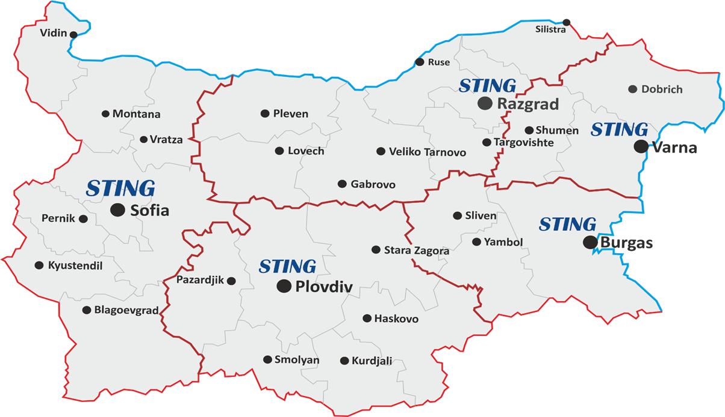
National Coverage - regional division of the territory serviced by STING AD warehouses

Slide 7
OBJECTIVE
To promote new suppliers providing exclusive rights to STING AD to market and distribute its products on the Bulgarian market using medical representatives and sales representatives for the projects assigned.
To increase the efficiency of the chain work: "Manufacturer-Sting-pharmacies" through initiatives such as VU (as a virtual union of pharmacies).....
To continue organizing and conducting marketing activities to support customers.
To maintain a leading position among distributors of pharmaceutical products in Bulgaria.
To achieve and maintain sustainable growth within 5 -8%.

Slide 8
ECONOMIC FACTORS macro environment
Gross domestic product (GDP) in the first quarter of 2020 decreased by 3.3% in the EU-27 compared to the previous quarter according to seasonally adjusted data. Over the same period, GDP in Bulgaria grew by 0.3%.and capable demand in payment are at critical point. Important are inflation rate , financial stability and percentage unemployment.
Social-cultural factors have a significant impact on our activities. The main cultural values ​​(literacy, low health culture, influences of media ads) have a constant impact , while the secondary values ones are more easily changed (for example high percentage of documents for temporary incapacity for work in line with the changing legalization).
The demographic structure of the population is a primary factor in consumer preferences and product prices …because in our country we have high morbidity and prevalence of chronic diseases, pensioners and the unemployed. The patients expect 100% coverage of medical services by the reimbursement system and free or low prices of medicinal products ....
The political and legislative environment is unstable and the factors, related to this environment, are reflected in laws and other connected legal documents for regulation of business, which has an international and internal aspects and aims different goals….. for example, to protect production, vertical business structures, corporate interests.
The innovation techno-informational environment and the acceleration of the scientific and technical achievements are the opportunity to use new technologies for improvement of the warehouses for storing goods.
Social media forms opinion in consumer !
The negative demographic trend is also related to the hiring employees for the company's activities. .... high percentage of depopulated regions!

Slide 9
Micro environment
Customers:
PHARMACIES - the most developing segment of the pharmaceutical market ! Two subjects determine the dynamic of the market - individual pharmacies and large chains of pharmacies …..
We observe “Sifting” of individual pharmacies in the period 2016-2017- which are undergone on restructure because of professional consultation and support from our side
DROGERIES .......
HOSPITALS (private, state) ?!

Slide 10
Micro environment
Suppliers
In 2019 the top 10 suppliers formed 46% from the whole turnover of all our supplies compared whit 39% in 2019..?!
Optimizations of the inventory with the purpose prompt turnover of the goods.
The supply from the manufacturer has to correspond to demand of the customers!
Increasing of the number of items has to follow-up the current marketing activities and demand ...?
To maintain the achieved level of sales in the previous year…
482 numbers of suppliers!

Slide 11
Pharma Marketing
STING MARKETING COMMUNICATION MIX:
Seminars “LEGЕ ARTIS” - every year 8 regional events to increase the professional qualification of 1200 pharmacists - type A, B and C.
VIRTUAL UNION " in focus“- full national coverage of pharmacies - training of counter situated pharmacist for promotional and consulting skills in seasons
Scientific marketing conference combined with an exhibition. It is performed with 500 top customers from the most reliable and successful pharmacies - type A and B.
Round tables 10 events for 200 pharmacies
The main goal is the pharmacists to gain skills for consultation and treatment of socially significant diseases - hypertension, asthma, osteoporosis, diabetes -in order to increase the health culture of the population…..
Product outsourcing (we can professionally present and promote different kind of products in front of pharmacists and doctors )…..
Co-operation with the
TRAINING
EXHIBITIONS
PROMOTIONS
M, E-PROJECTS

Slide 12
Activities
Pharmacy Design and Equipment- provide specialized pharmacy a furniture, in order to comply to the GPP standards
“PharmaStar” pharmacy software, aimed to assist pharmacy management optimization.
WEBSITE for on-line orders and payments, marketing and promotions of products

Slide 13
FUTURE GROWTH … ANALYSIS AND THE NEED FOR BALANCE
As healthcare marketers we all take into account that the healthcare is continuously developing process and that the need of “focus on patients” is critical for the commercial success. However, the reality is that daily business pressures and deeply ingrained processes often subjugate patient centricity to a “plaque on the wall” in the legislative conference room. Many companies find it challenging to implement change and create a truly patient orientated organization .
Тhat is why the management of Sting AD always finds the right way to ensure public health by implementing socially responsible marketing and expeditious logistics.
"Trade resists all winds, It defies even the most powerful storm
and enters in every area "
George Bancroft

